Slide 2




About Devtron
Vision
Founded in 2019 with the vision to simplify the operations and management of kubernetes Infrastructure and its workloads.
Rajesh Razdan (Co-founder)
Manish has 25+ years of business development, product management, channels, strategic alliances, marketing and strategy functions. Before Devtron, was co-founder of mCarbon where he supported global Telcos through technology based offerings to upsell and cross sell more continuous usage and return based business models. Previously, he held senior positions with leading Telecom Organizations including KPN International Consulting, Nokia, Ericsson, and Roamware.
In his present capacity, Rajesh steers the company’s growth and go to market.
Our Investors
Prashant Ghildiyal (Co-founder)
With two decades of experience in technology, Prashant is an experienced technologist, having worked across various facets of tech, including DevOps, Kubernetes, data sciences, AI/ML and building applications from scratch for millions of users at scale. He is a passionate advocate for democratizing the adoption of Kubernetes through open-source tools and mentorship.
Prashant with his deep understanding of technology drives product innovation and vision at Devtron.
10,000+ Global Installations & Counting

Slide 3
About Us
Nishant Kumar (Co-founder)
Nishant is a master of technology and a problem solver who doubles as a firefighter to heavy lift the technology challenges at hand at Devtron. He has worked hands-on across high throughput distributed systems, complex technology architecture in his past roles.
Nishant is the brain behind the technology at Devtron.
Manish Verma (Core team member)
Manish is a telecom industry veteran with more than 25 years of experience across a spectrum of sales & business management, as well as technology strategy & portfolio development. He has successfully developed and grown a targeted portfolio across telco cloud, orchestration, automation, analytics, voice and data core over next generation infrastructure etc. leading to more than tripling of the business across the India market under him.
Manish is leading the Telco vertical at Devtron and is working actively with customers and partners to grow our outreach at a fast pace.
Our Investors
10,000+ Global Installations & Counting

Slide 4







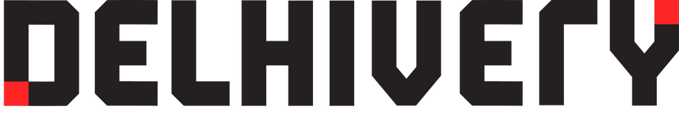










Our Customers
Fintech | Telecom | AI/ML/ Big Data | Automotive | IoT/ Gaming | Other Enterprises
and many more...
10,000+ Global Installations & Counting

Slide 5


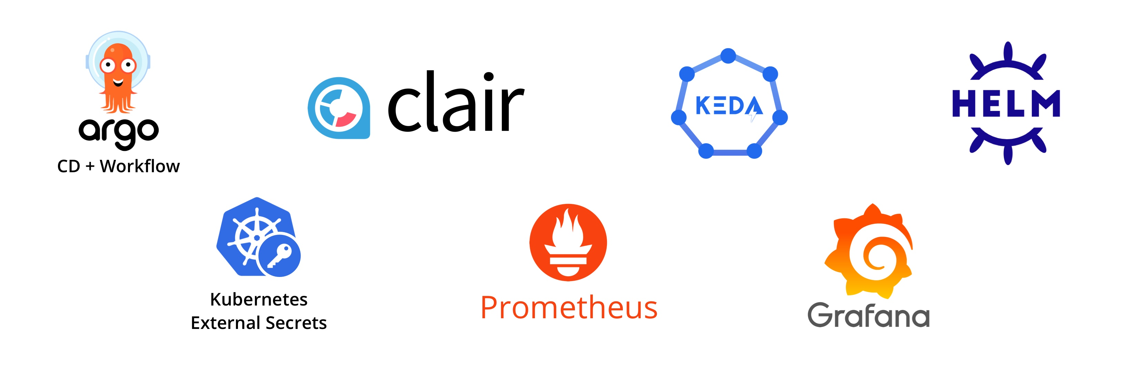

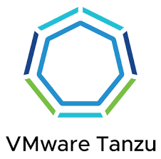
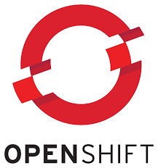





Solution Overview
Devtron UI
Customizable Wizards
Console
Orchestrator
Policy
Engine
Monitor
Storage Engine
GitOps Engine
Collaboration Engine
Notifier
Approval Engine
Configuration Engine
Hierarchical Security
Watcher
Multi-Cluster
Workflow
Multi-Cluster
Edge
Technologies built on
Cloud
Network
IAAS

Slide 6
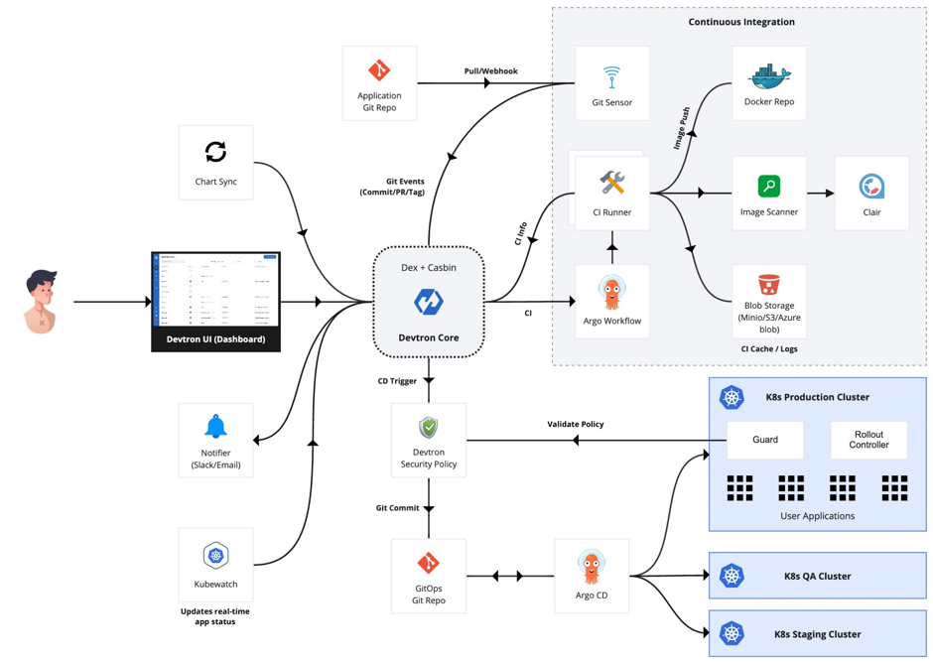
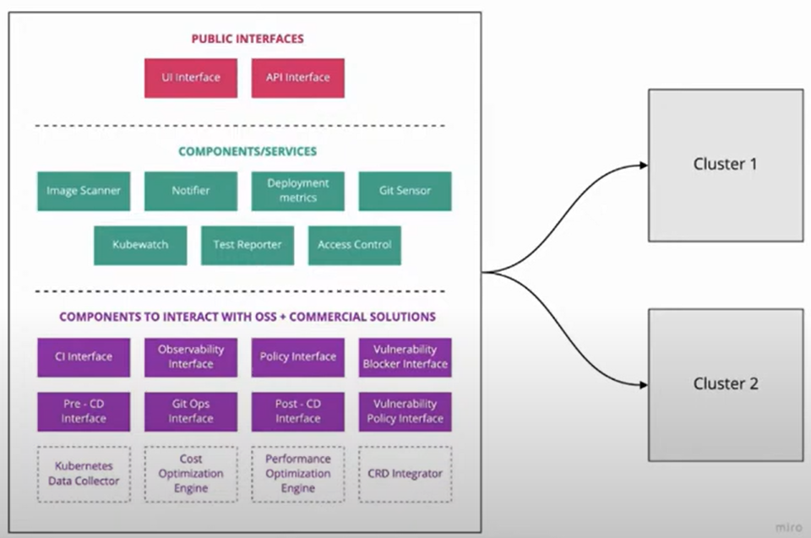
Architecture
Functional Flow
Hireachcial components

